Slide 1
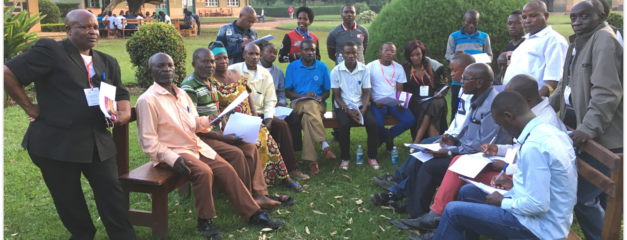
Church Owned Bible Translation
Keep your heart with all diligence, for out of it spring the issues of life (Prov. 4:23).
Walk in wisdom toward those who are outside, redeeming the time (Col. 4:5).
All Scripture is taken from the New King James Version®. © 1982 by Thomas Nelson, Inc. Used by permission. All rights reserved.
Six Behaviors

Slide 2
?
What actions do we see in a local church that believes in COBT?

Slide 3
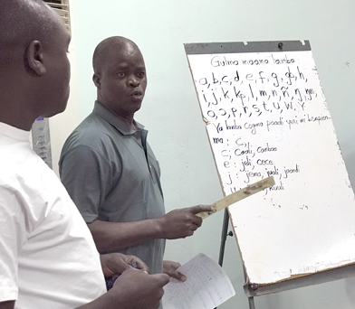

1. Accept the responsibility to do a Bible translation
Takes
Responsibility
Local Church
Bible translation
So they read distinctly from the book, in the Law of God; and they gave the sense, and helped them to understand the reading (Nehemiah 8:8)

Slide 4
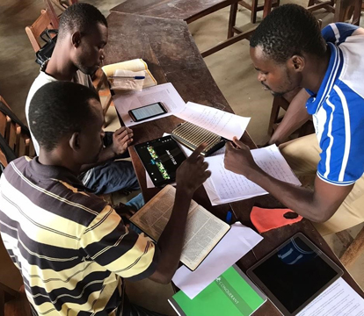

2. Make Bible translation accessible
Manages
Accessibility
Local Church
And daily in the temple, and in every house, they did not cease teaching and preaching Jesus as the Christ (Acts 5:42).

Slide 5

3. Refine and revise the translation
Checking
Refine
Translate
Revise
Local Church
And let us not grow weary while doing good, for in due season we shall reap if we do not lose heart (Galatians 6:9).

Slide 6
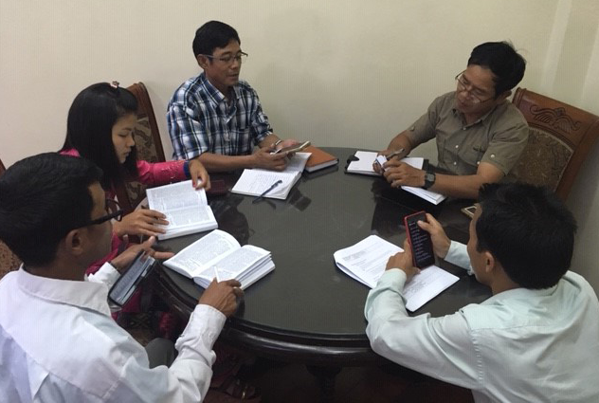
4. Engage community in Scripture usage
All Scripture is given by inspiration of God, and is profitable for doctrine, for reproof, for correction, for instruction in righteousness, ¹⁷ that the man of God may be complete, thoroughly equipped for every good work
(2 Timothy 3:16-17).

Slide 7
5. Share COBT with others
He answered and said to them, “He who has two tunics, let him give to him who has none; and he who has food, let him do likewise.” (Luke 3:11)

Slide 8
6. Lead future generations to update and revise.
You
Your children
Your grandchildren
“And these words which I command you today shall be in your heart. ⁷ You shall teach them diligently to your children, and shall talk of them when you sit in your house, when you walk by the way, when you lie down, and when you rise up (Deuteronomy 6:6-7).
So they read distinctly from the book, in the Law of God; and they gave the sense, and helped them to understand the reading (Nehemiah 8:8).

